Slide 1

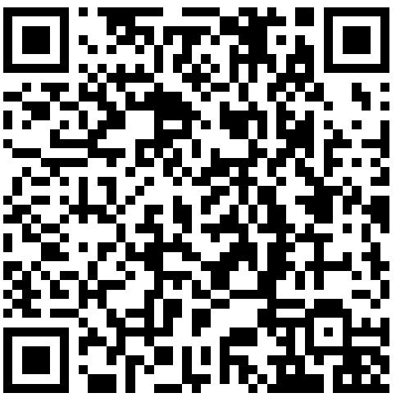
Our Fraternity
https://california-college.alphasigmadelta-fraternity.com
Aspire Seek Discover

Slide 2


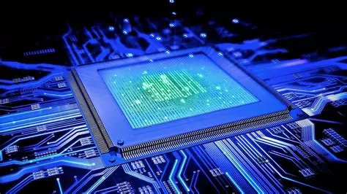
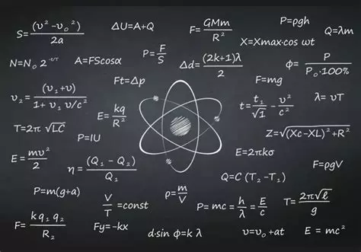
About us

Slide 3

Symbols and identity

Slide 4

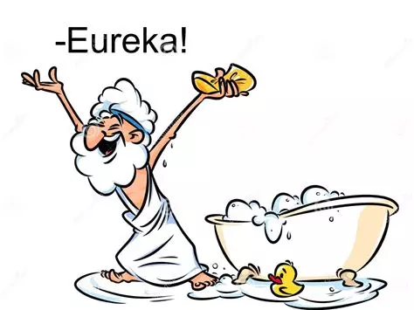
Traditions and Brotherhood
Light of Discovery

Slide 5
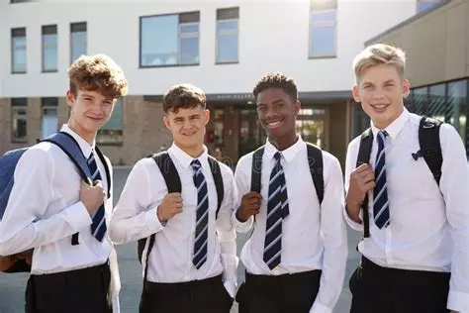
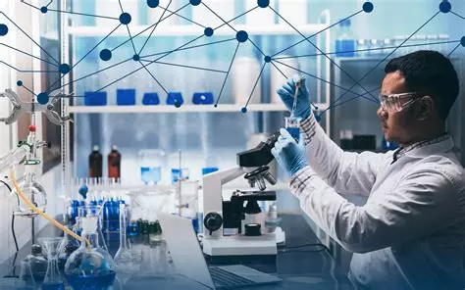
Organisational Structure

Slide 6

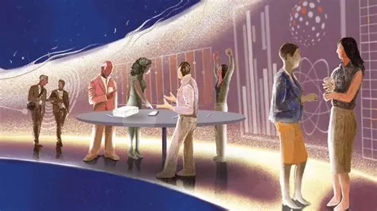
Recruitment and initiation
Night Discovery

Slide 7
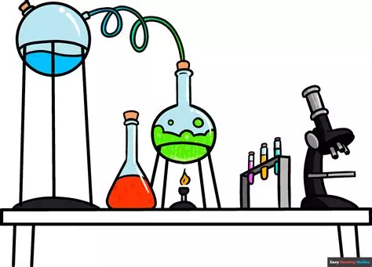
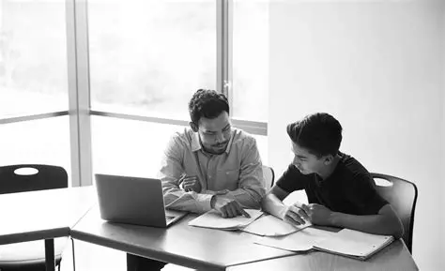

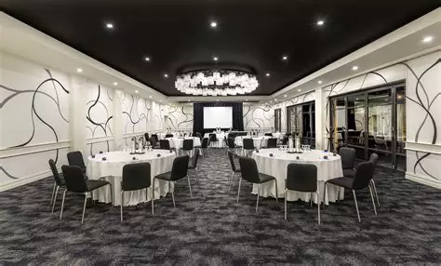
Events
Science Night
Tutoring
Innovation fair
Annual Gala

Slide 8

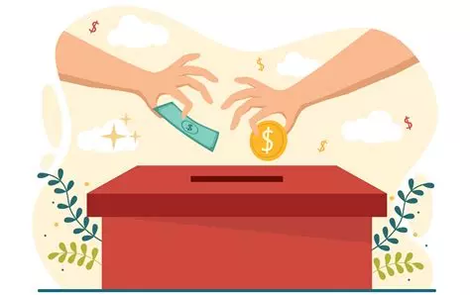
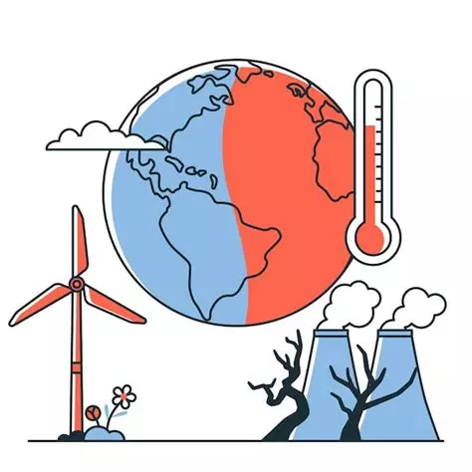
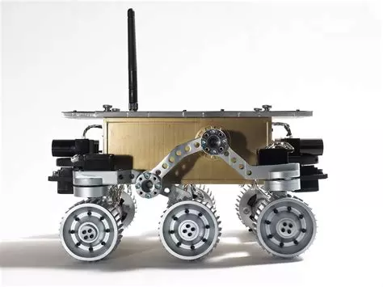
Philanthropy and Volunteer work
Medical
Funding Campaign
Climate
Engineering

Slide 9




Website
https://california-college.alphasigmadelta-fraternity.com

Slide 10
ΑΣΔ
Aspire Seek Discover!
Light of Discovery

